Slide 1
VIRTUALMEMORY MANAGEMENT
BSCS-IV

Slide 2
VIRTUAL MEMORY MANAGEMENT
Virtual Memory is a storage allocation scheme in which secondary memory can be addressed as though it were part of the main memory.
Virtual memory uses both hardware and software to enable a computer to compensate for physical memory shortages, temporarily transferring data from random access memory (RAM) to disk storage.
Mapping chunks of memory to disk files enables a computer to treat secondary memory as though it were main memory.

Slide 3
VIRTUAL MEMORY MANAGEMENT
Today, most personal computers (PCs) come with at least 8 GB (gigabytes) of RAM.
But, sometimes, this is not enough to run several programs at one time.
This is where virtual memory comes in.
Virtual memory frees up RAM by swapping data that has not been used recently over to a storage device, such as a hard drive or solid-state drive (SSD).

Slide 4
THRASHING
Virtual memory is important for improving system performance, multitasking and using large programs.
However, users should not overly rely on virtual memory, since it is considerably slower than RAM.
If the OS has to swap data between virtual memory and RAM too often, the computer will begin to slow down -- this is called thrashing.

Slide 5
WHY VIRTUAL MEMORY?
Virtual memory was developed at a time when physical memory -- also referenced as RAM -- was expensive.
Computers have a finite amount of RAM, so memory will eventually run out when multiple programs run at the same time.
A system using virtual memory uses a section of the hard drive to emulate RAM. With virtual memory, a system can load larger or multiple programs running at the same time, enabling each one to operate as if it has more space, without having to purchase more RAM.

Slide 6
HOW VIRTUAL MEMORY WORKS?
Virtual memory uses both hardware and software to operate. When an application is in use, data from that program is stored in a physical address using RAM. A memory management unit (MMU) maps the address to RAM and automatically translates addresses. The MMU can, for example, map a logical address space to a corresponding physical address.
If, at any point, the RAM space is needed for something more urgent, data can be swapped out of RAM and into virtual memory. The computer's memory manager is in charge of keeping track of the shifts between physical and virtual memory. If that data is needed again, the computer's MMU will use a context switch to resume execution.

Slide 7
HOW VIRTUAL MEMORY WORKS?
While copying virtual memory into physical memory, the OS divides memory with a fixed number of addresses into either pagefiles or swap files. Each page is stored on a disk, and when the page is needed, the OS copies it from the disk to main memory and translates the virtual addresses into real addresses.
However, the process of swapping virtual memory to physical is rather slow. This means using virtual memory generally causes a noticeable reduction in performance. Because of swapping, computers with more RAM are considered to have better performance.

Slide 8
TYPES OF VIRTUAL MEMORY MANAGEMENT
Paged
Segmented

Slide 9
TYPES OF VIRTUAL MEMORY MANAGEMENT
1. DEMAND PAGING
Paging divides memory into sections or paging files.
When a computer uses up its available RAM, pages not in use are transferred to the hard drive using a swap file.
A swap file is a space set aside on the hard drive to be used as the virtual memory extension for the computer's RAM.
When the swap file is needed, it is sent back to RAM using a process called page swapping. This system ensures the computer's OS and applications do not run out of real memory.

Slide 10
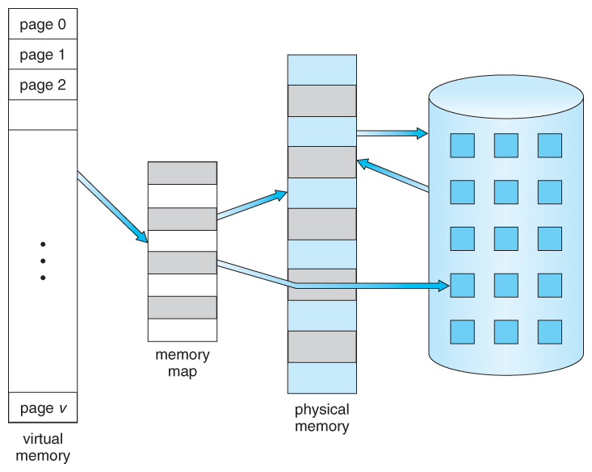
TYPES OF VIRTUAL MEMORY MANAGEMENT
1. DEMAND PAGING

Slide 11
PAGE FAULT
The virtual memory paging process uses page tables, which translate the virtual addresses that the OS and applications use into the physical addresses that the MMU uses.
Entries in the page table indicate whether the page is in RAM.
If the OS or a program does not find what it needs in RAM, then the MMU responds to the missing memory reference with a page fault exception to get the OS to move the page back to memory when it is needed.
Once the page is in RAM, its virtual address appears in the page table.

Slide 12
SEGMENTATION
Segmentation is also used to manage virtual memory.
This approach divides virtual memory into segments of different lengths.
Segments not in use in memory can be moved to virtual memory space on the hard drive.
Segmented information or processes are tracked in a segment table, which shows if a segment is present in memory, whether it has been modified and what its physical address is. In addition, file systems in segmentation are only made up of segments that are mapped into a process's potential address space.

Slide 13
PAGING VS SEGMENTATION
Segmentation and paging differ as a memory model in terms of how memory is divided; however, the processes can also be combined.
In this case, memory gets divided into frames or pages. The segments take up multiple pages, and the virtual address includes both the segment number and the page number.

Slide 14
ADVANTAGES OF USING VMM
The advantages to using virtual memory include:
It can handle twice as many addresses as main memory.
It enables more applications to be used at once.
It frees applications from managing shared memory and saves users from having to add memory modules when RAM space runs out.
It has increased speed when only a segment of a program is needed for execution.
It has increased security because of memory isolation.
It enables multiple larger applications to run simultaneously.
Allocating memory is relatively inexpensive.
It does not need external fragmentation.
CPU use is effective for managing logical partition workloads.
Data can be moved automatically.
Pages in the original process can be shared during a fork system call operation that creates a copy of itself.

Slide 15
LIMITATIONS
Applications run slower if they are running from virtual memory.
Data must be mapped between virtual and physical memory, which requires extra hardware support for address translations, slowing down a computer further.
The size of virtual storage is limited by the amount of secondary storage, as well as the addressing scheme with the computer system.
Thrashing can occur if there is not enough RAM, which will make the computer perform slower.
It may take time to switch between applications using virtual memory.
It lessens the amount of available hard drive space.

Slide 16
PAGE FAULT
A page fault happens when a running program accesses a memory page that is mapped into the virtual address space but not loaded in physical memory.
Since actual physical memory is much smaller than virtual memory, page faults happen. In case of a page fault, Operating System might have to replace one of the existing pages with the newly needed page. Different page replacement algorithms suggest different ways to decide which page to replace.
The target for all algorithms is to reduce the number of page faults.

Slide 17
PAGE REPLACEMENT ALGORITHMS
1. First In First Out (FIFO):
This is the simplest page replacement algorithm.
In this algorithm, the operating system keeps track of all pages in the memory in a queue, the oldest page is in the front of the queue.
When a page needs to be replaced, page in the front of the queue is selected for removal.

Slide 18
First In First Out (FIFO)
This is the first basic algorithm of Page Replacement Algorithms.
This algorithm is basically dependent on the number of frames used.
Then each frame takes up the certain page and tries to access it.
When the frames are filled then the actual problem starts.
The fixed number of frames is filled up with the help of first frames present.
This concept is fulfilled with the help of Demand Paging.

Slide 19
First In First Out (FIFO)
After filling up of the frames, the next page in the waiting queue tries to enter the frame.
If the frame is present then, no problem is occurred. Because of the page which is to be searched is already present in the allocated frames.
If the page to be searched is found among the frames then, this process is known as Page Hit.
If the page to be searched is not found among the frames then, this process is known as Page Fault.

Slide 20
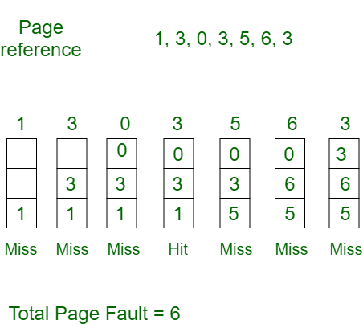
First In First Out (FIFO)
Example 1:
Consider page reference string 1, 3, 0, 3, 5, 6, 3 with 3 page frames. Find the number of page faults.

Slide 21
FIFO Continued . . .
Initially, all slots are empty, so when 1, 3, 0 came they are allocated to the empty slots —> 3 Page Faults.
when 3 comes, it is already in memory so —> 0 Page Faults.
Then 5 comes, it is not available in memory so it replaces the oldest page slot i.e 1. —>1 Page Fault.
6 comes, it is also not available in memory so it replaces the oldest page slot i.e 3 —>1 Page Fault.
Finally, when 3 come it is not available so it replaces 0 1 page fault.

Slide 22
FIRST IN FIRST OUT (FIFO)
EXAMPLE:2
Consider the reference string 6, 1, 1, 2, 0, 3, 4, 6, 0, 2, 1, 2, 1, 2, 0, 3, 2, 1, 2, 0 for a memory with three frames and calculate number of page faults by using FIFO (First In First Out) Page replacement algorithms.

Slide 23
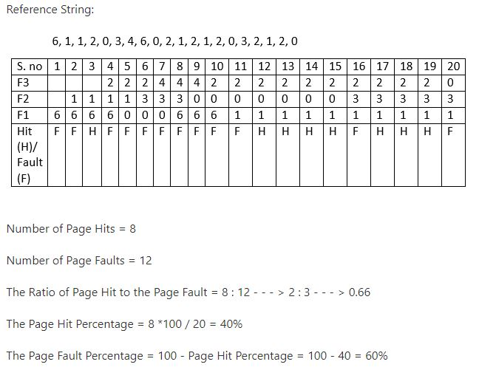
FIRST IN FIRST OUT (FIFO)

Slide 24
Belady’s anomaly
Proves that it is possible to have more page faults when increasing the number of page frames while using the First in First Out (FIFO) page replacement algorithm.
For example, if we consider reference strings 3, 2, 1, 0, 3, 2, 4, 3, 2, 1, 0, 4, and 3 slots, we get 9 total page faults, but if we increase slots to 4, we get 10-page faults.

Slide 25
OPTIMAL REPLACEMENT ALGORITHM
In this algorithm, pages are replaced which would not be used for the longest duration of time in the future.
Example: Consider the page references 7, 0, 1, 2, 0, 3, 0, 4, 2, 3, 0, 3, 2, 3 with 4 page frame. Find number of page fault.

Slide 26
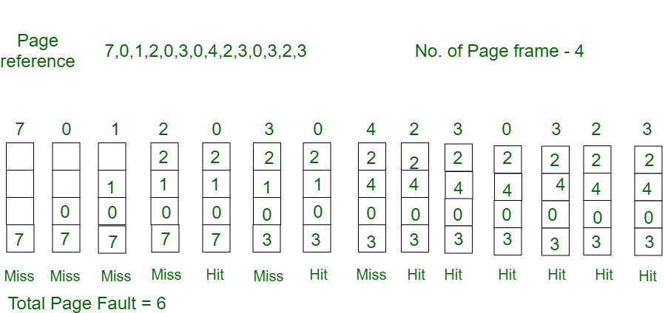
OPTIMAL REPLACEMENT ALGORITHM

Slide 27
OPTIMAL REPLACEMENT ALGORITHM
Initially, all slots are empty, so when 7 0 1 2 are allocated to the empty slots —> 4 Page faults 0 is already there so —> 0 Page fault. when 3 came it will take the place of 7 because it is not used for the longest duration of time in the future.—>1 Page fault. 0 is already there so —> 0 Page fault. 4 will takes place of 1 —> 1 Page Fault.
Now for the further page reference string —> 0 Page fault because they are already available in the memory. Optimal page replacement is perfect, but not possible in practice as the operating system cannot know future requests. The use of Optimal Page replacement is to set up a benchmark so that other replacement algorithms can be analyzed against it.

Slide 28
LEAST RECENTLY USED ALGORITHM
In this algorithm, page will be replaced which is least recently used.
Example-3: Consider the page reference string 7, 0, 1, 2, 0, 3, 0, 4, 2, 3, 0, 3, 2, 3 with 4 page frames. Find number of page faults.

Slide 29
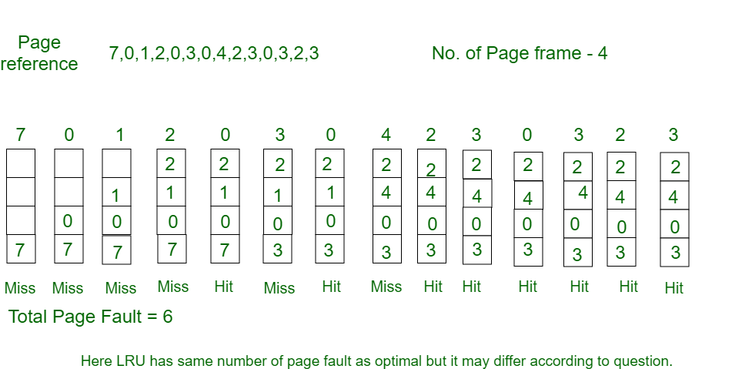
LEAST RECENTLY USED ALGORITHM

Slide 30
4. MOST RECENTLY USED AGORITHM
In this algorithm, page will be replaced which has been used recently.
Belady’s anomaly can occur in this algorithm.

